Slide 1
FH-score and SoP-score on Goldbeter
By Michelle Goodman 2/3/2017
Aims:
When will the wave penetrate
Can you Predict the depth of penetration

Slide 2
Introduction
Previously I have been able to look at a given wave profile and decide if it will penetrate past the bifurcation point based on two criteria:
The wave profile of x* must be asymmetric
Ie: must be front-heavy
The frequency of oscillation must increase from x* to x* + dx
Ie: f(x*) < f(x*+dx)
I would now like to quantify the front-heavy-ness of a concentration wave profile as a FH-score

Slide 3
What is an FH-score?
The FH-score represents the maximum net flux of concentration passed from some cell x* to the cell x* -dx
When this net flux is positive the wave will penetrate
Ie when the FH-score > 0 the wave has the ability to penetrate

Slide 4
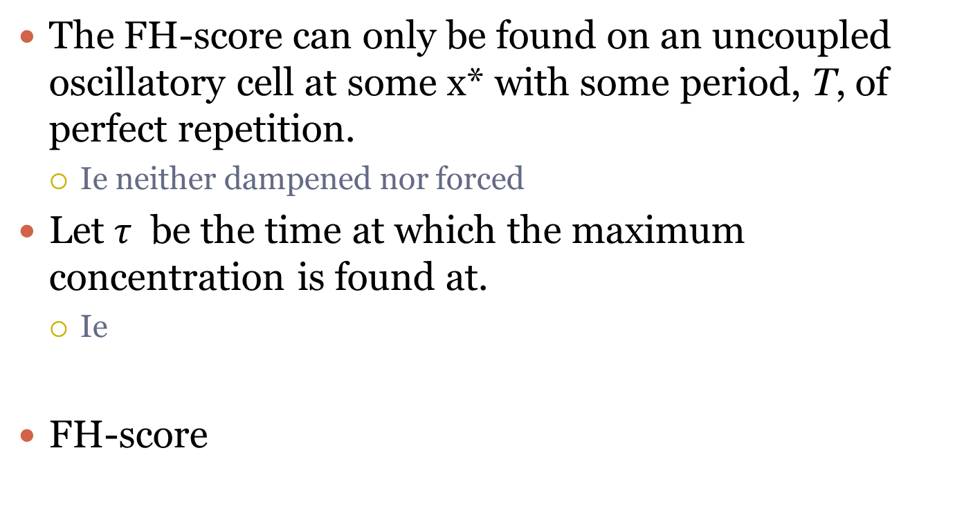

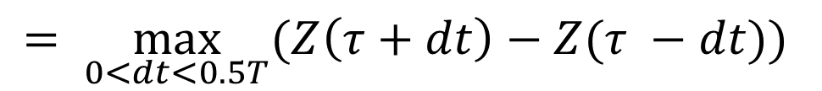
How do you find the FH-score [$μM$]
The FH-score can only be found on an uncoupled oscillatory cell at some x* with some period, T, of perfect repetition.
Ie neither dampened nor forced
Let $τ$ be the time at which the maximum concentration is found at.
Ie
FH-score
$$\max_{t ∈ ℝ_{>0}}{(Z\left(t\right))=Z\left(τ\right),} where ℝ_{>0}=\left\{x∈ ℝ \right|x>0 \}$$
$$= \max_{0<dt<0.5T}{(Z\left(τ+dt\right)−Z(τ −dt))}$$

Slide 5
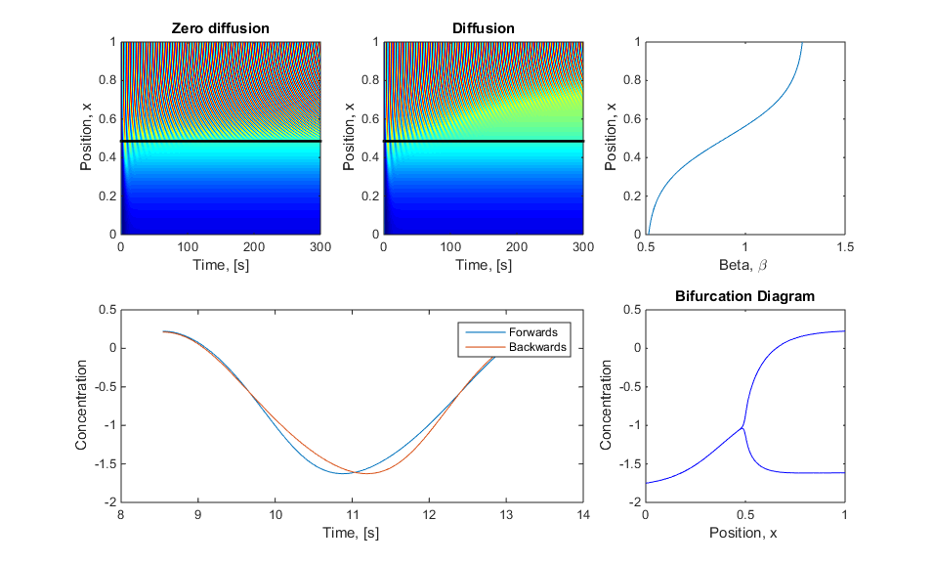
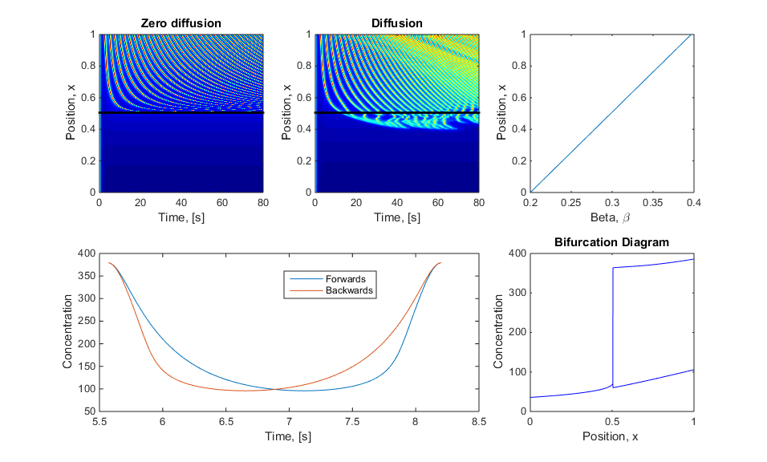
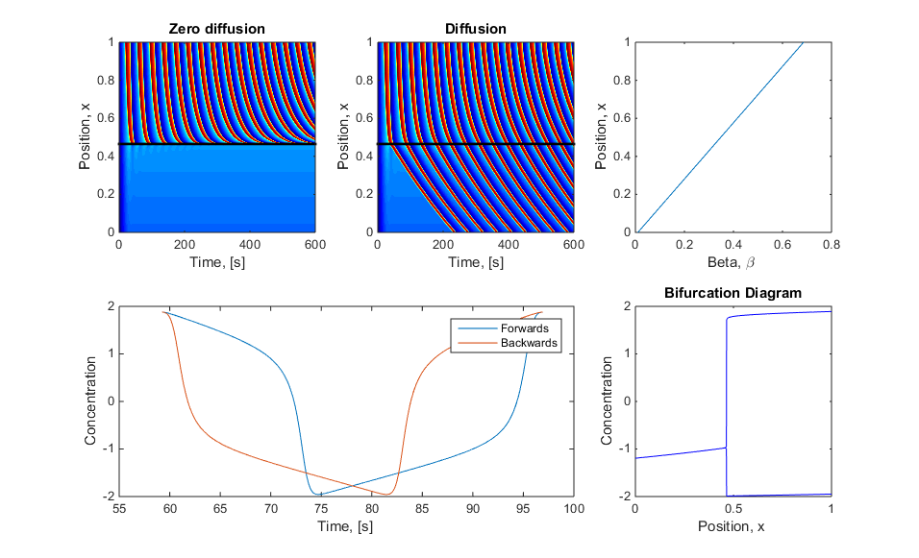
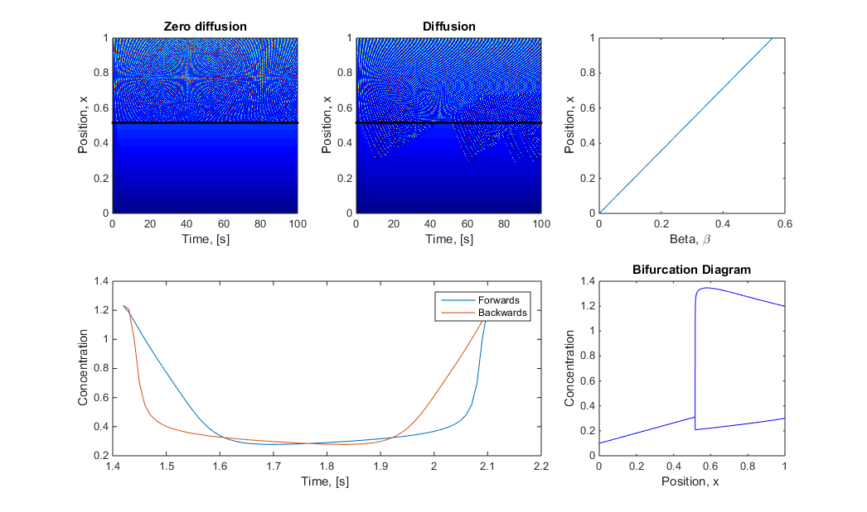
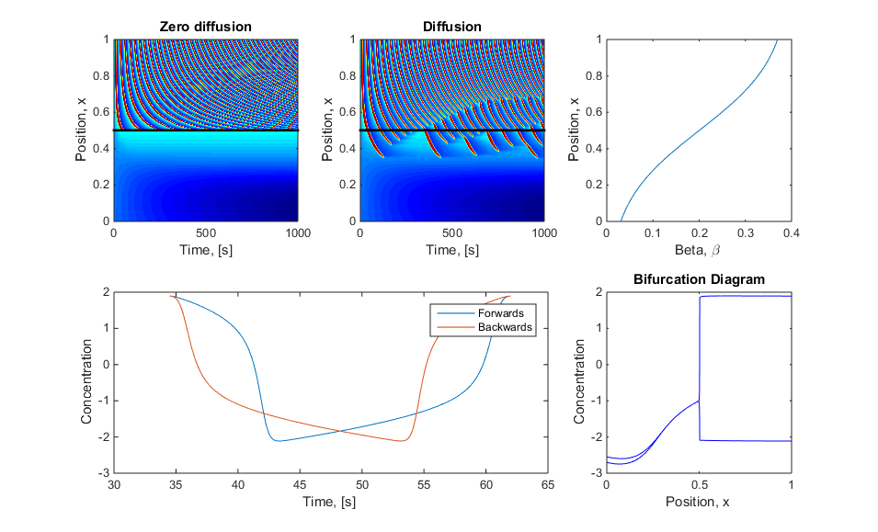
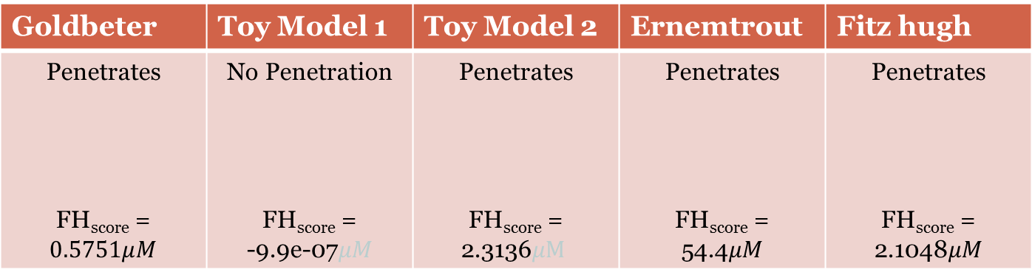
Example of FH-score
Goldbeter | Toy Model 1 | Toy Model 2 | Ernemtrout | Fitz hugh
Penetrates FH_{score} = $$0.5751μM$$ | No Penetration FH_{score} = -9.9e-07$μM$ | Penetrates FH_{score} = 2.3136$μM$ | Penetrates FH_{score} = 54.4$μM$ | Penetrates FH_{score} = 2.1048$μM$
Note: You can find a FH-score for each beta value in the oscillatory region

Slide 6
Is FH-score Enough?
Being able to determine the FH-score tells us if it will be able to penetrate
However, as Paul pointed out, it does not matter what shape the concentration wave is if it is sitting next to a ‘cell’ with a beta value of zero it will not penetrate
NO

Slide 7
New Hypothosis
Not only does the initial criteria need to be met
The wave profile of x* must be asymmetric
FH-score> 0
The frequency of oscillation must increase from x* to x* + dx
But also the cell next door at x*- dx must be accepting to the change
This got me thinking about a ‘cells’ stability when it is perturbed

Slide 8
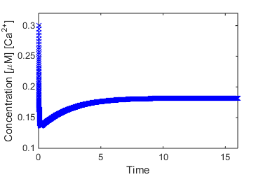



What Do I mean by ‘Stability when Perturbed’
If we take a uncoupled ‘cell’ of some beta value $β^{∗}$ and found its steady state value:
Initial Conditions
In this case I used:
Goldbeter Model
$β^{∗}$ = 0.2
Z_{ss} = 0.1818 $μM$
V_{ss} = -36.48 $mV$
Y_{ss} = 1.7246 $μM$
Steady state for $β^{∗}$

Slide 9
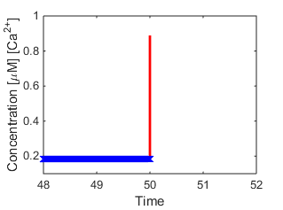

What Do I mean by ‘Stability when Perturbed’
Next we perturbe the cell by adding an amount, P, of [Ca²⁺] concentration to the steady state solution
Z+P
Steady state for $β^{∗}$

Slide 10
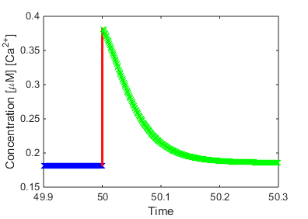
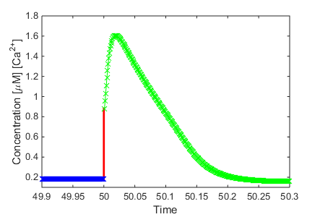



What Do I mean by ‘Stability when Perturbed’
Now the simulation is run until the cell returns back to steady state
Depending of the pertubation P different results are possible:
Small Perturbation, P = 0.2 $μM$
Larger Perturbation, P = 0.7 $μM$
‘Stimulated the cell’
Steady state for $β^{∗}$

Slide 11
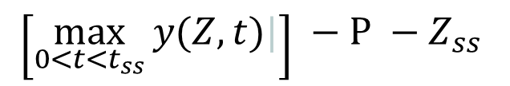
New SoP-score(cell, P)
Stability of Perturbed score is found for an uncoupled stead state ‘cell’ for some perturbation, P.
Given that steady state is reached such that solution_{ss} = [Z_{ss}, Y_{ss}, V_{ss}, … ]
Perturbate the system such that IC(t=0) = [Z_{ss}+P, Y_{ss}, V_{ss}, … ]
Run until for some t = t_{ss} such that steady state is reached y(t=t_{ss}) =solution_{ss}
SoP-score =
$$\left[\max_{0<t<t_{ss}}{y(Z, t)|}\right] −P −Z_{ss}$$

Slide 12
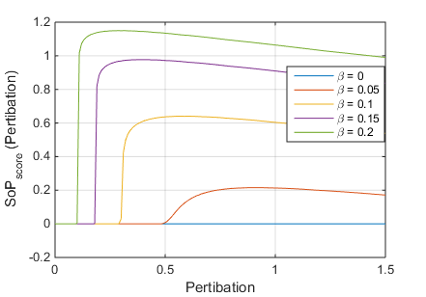
Example of SoP-score

Slide 13
Final Set of Criteria to Penetrate
The wave profile of x* must be asymmetric
Ie: the FH-score> 0
The frequency of oscillation must increase from x* to x* + dx
Ie: f(x*) < f(x*+dx)
The cell at x*- dx must be accepting to the change
Ie: the SoP_{score}(x*-dx, FH_{score}(x*)) > 0

Slide 14
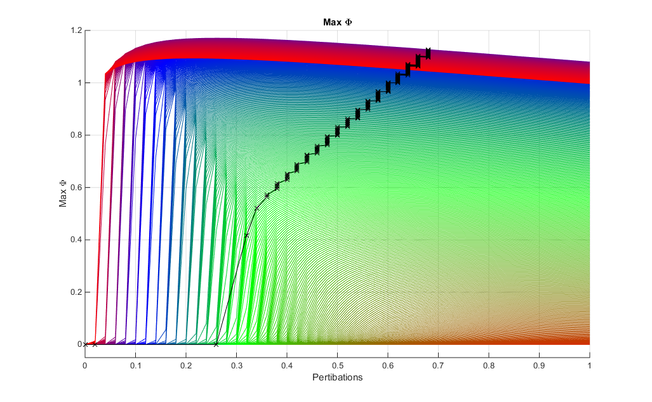
Depth of penetration

